Slide 1
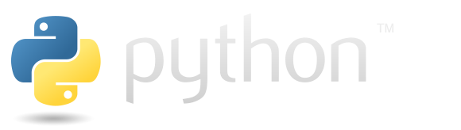
Troy Squillaci

Slide 2

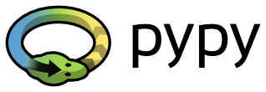
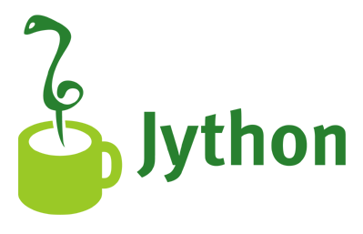
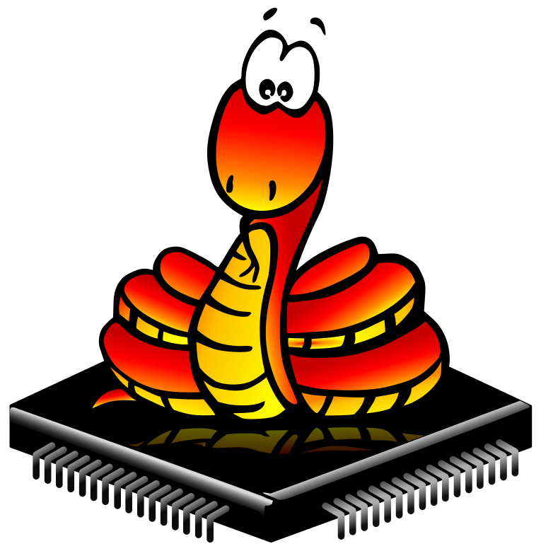
Major Implementations
C# Implementation offering interop with .NET
JIT compiled implementation focused on speed
CPython - Reference Implementation
Embedded light-weight implementation for microcontrollers
Run on the Java platform interop with Java

Slide 3


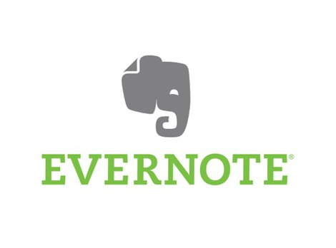

Who Uses Python?

Slide 4
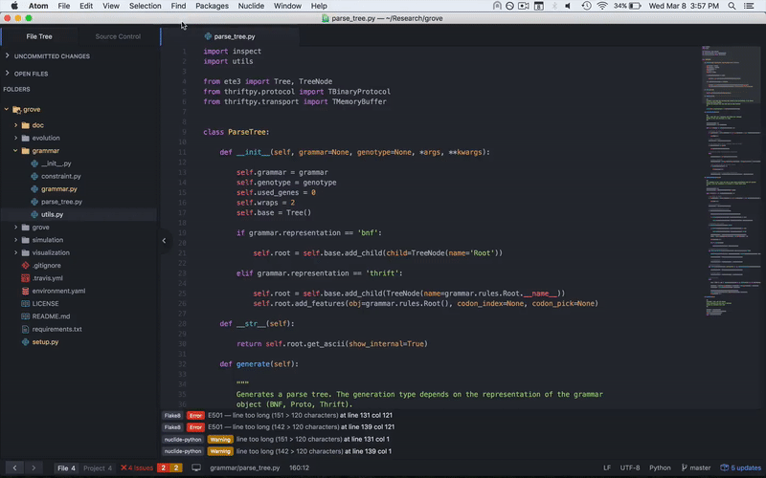
Editors and IDEs - Atom

Slide 5
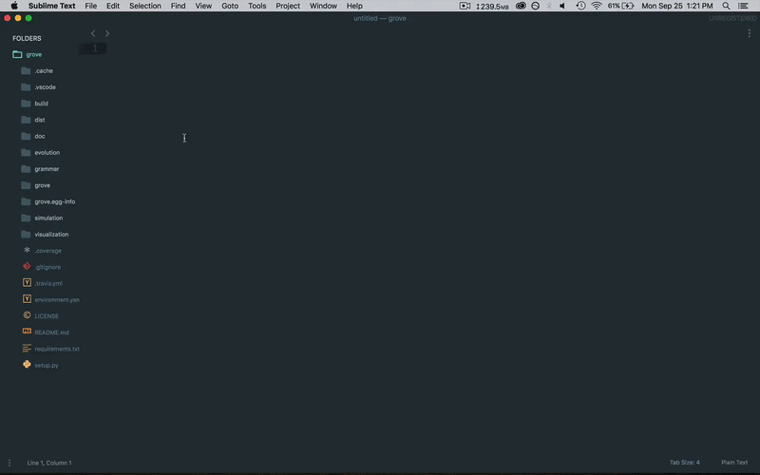
Editors and IDEs - Sublime Text

Slide 6
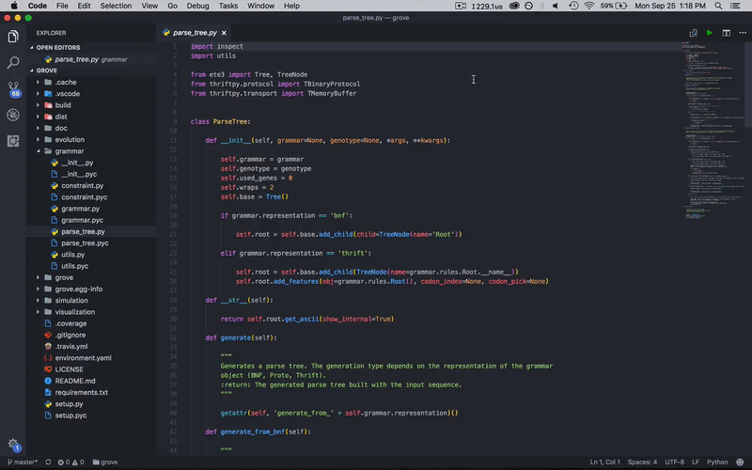
Editors and IDEs - Visual Studio Code

Slide 7
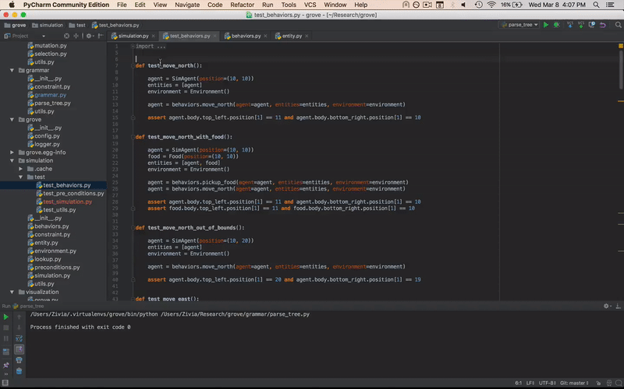
Editors and IDEs - PyCharm

Slide 8
Typing
Duck Typing
“If it looks like a duck, swims like a duck, and quacks like a duck, it’s probably a duck.”
Concerned with the presence of methods and properties of an object rather than just its type.
All type checking is deferred until runtime.
Dynamically Typed
Strongly Typed
Use the type() function to get the type of an object.

Slide 9
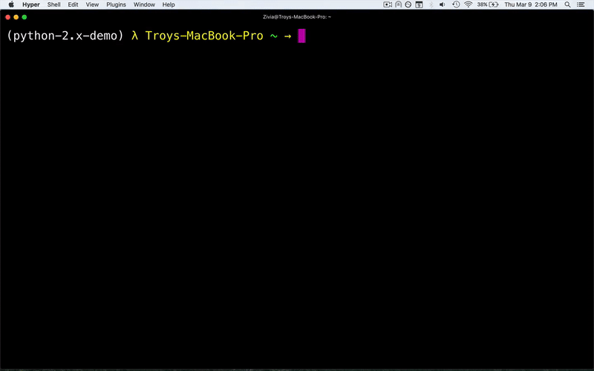
Paradigms - Object-oriented
Automatic garbage collection
Objects may be callable (treated as a function)
Special methods for operator overloading

Slide 10
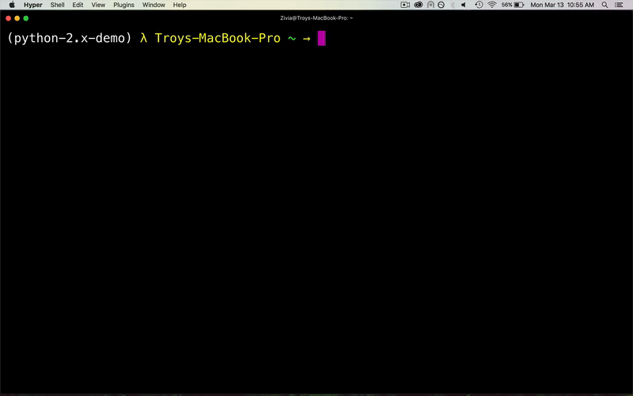
Paradigms - Imperative
Define functions outside of objects
Concerned with how to do things, not what things are (opposite of functional programming)

Slide 11
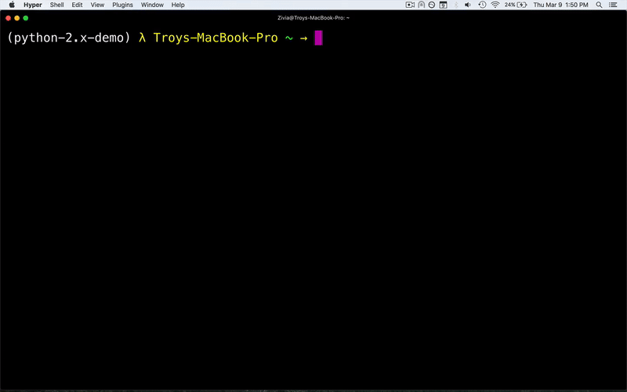
Paradigms - Functional
Lexical Closure
First-class Functions
Lambdas
Recursion (no tail)
Comprehensions
Partial Application (pseudo-curry)

Slide 12
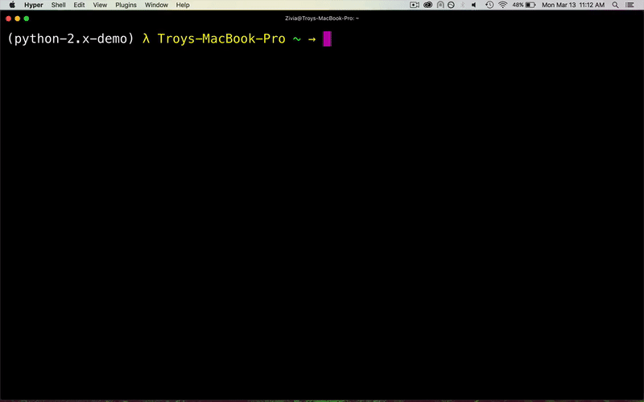
Paradigms - Reflective
Four main reflection mechanisms
delattr()
getattr()
hasattr()
setattr()
Works on all objects (note modules are objects too)

Slide 13
PEP - Python Enhancement Proposal(s)
PEPs are lists of proposals that aim to improve various aspects of Python
Listed by numbers, which never change, preserving a historical record
Notable PEPs
PEP 0 - Index of Python Enhancement Proposals (PEPs)
PEP 8 - Styling Guide for Python Code
PEP 20 - The Zen of Python

Slide 14
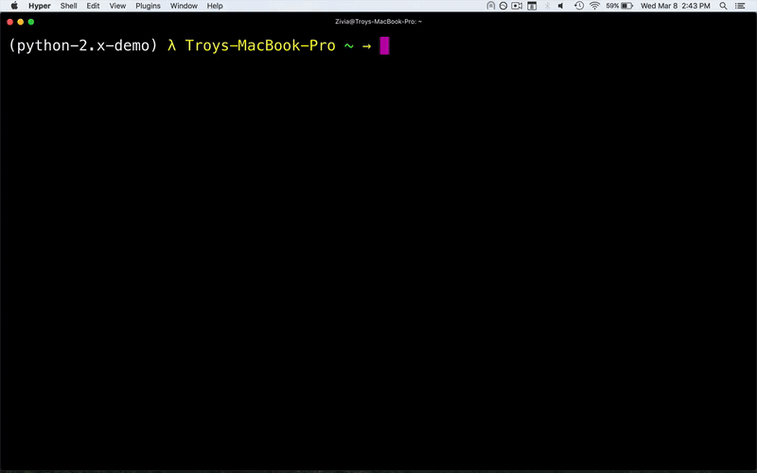
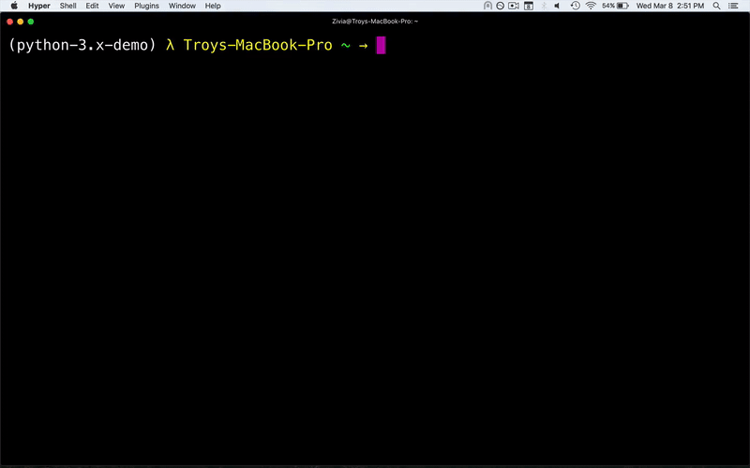
Python 2.x
Python 3.x
Old Print Function
New Print Function

Slide 15
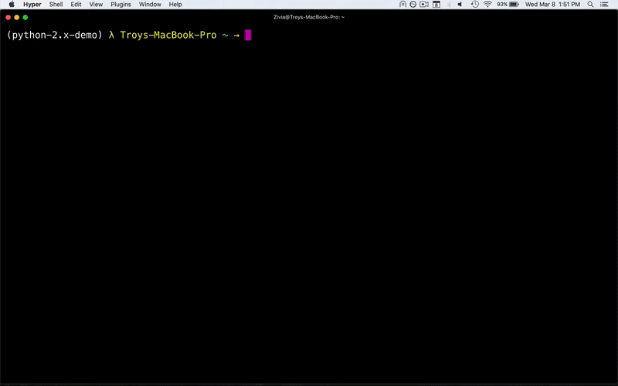
The __future__ Module
Import some incompatible Python 3.x features into Python 2.x
PEP 238 - Changing the Division Operator

Slide 16
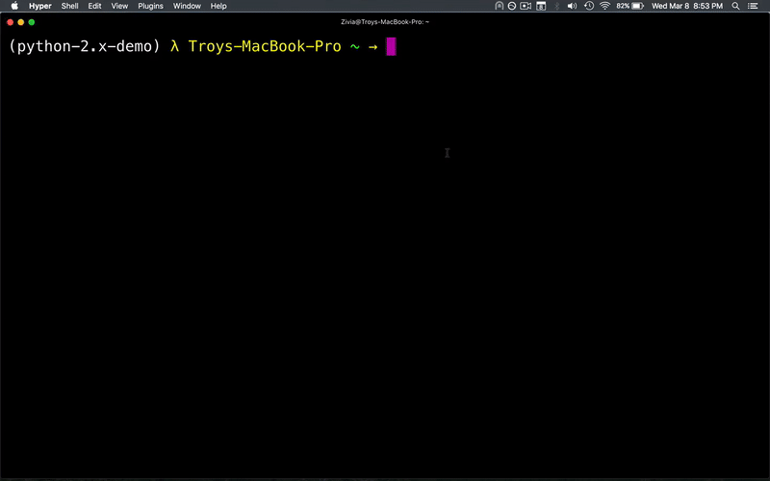
The 2to3 Module
Module for automated code migration
Port Python 2.x to Python 3.x

Slide 17
The Future of Python 2.x
PEP 373 - Python 2.7 Release Schedule
End-of-life for Python 2.7 projected for 2020
Will still be used by many, but no longer maintained
Active libraries will be migrating to Python 3.x
Comprehensive list of changes in Python 3.x

Slide 18
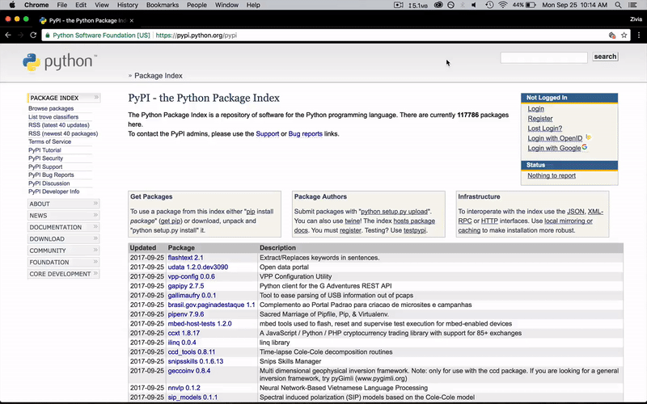
PyPI - Python Package Index
The official Python code repository with over 100000 packages
Upload your own packages!

Slide 19
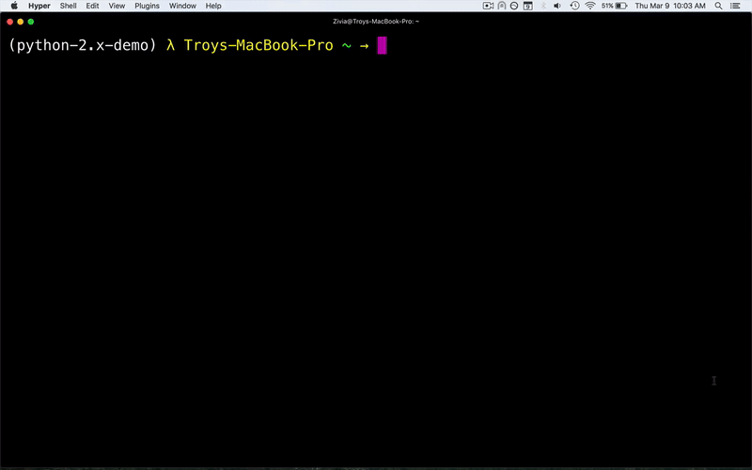
pip - Package Manager for PyPI
pip stands for pip installs packages (recursive acronym)
Easiest way to download and manage packages from PyPI

Slide 20
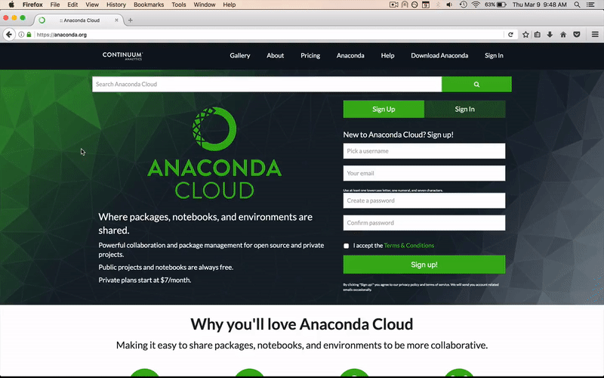
Anaconda - Another Repository
The de-facto repository for data science packages
Supports non-Python dependencies as well

Slide 21

conda - Package Manager for Anaconda
Setup complete environments for any Python version
Provision non-Python dependencies instantly

Slide 22

virtualenv - Isolated Python Environments
Manage numerous Python versions and dependencies in isolation
Conda supports the same functionality, including pip

Slide 23
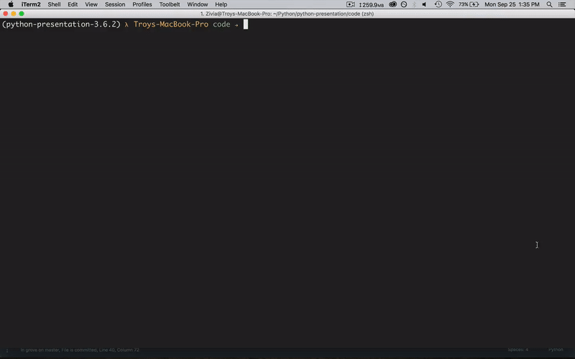
mypy - Optional Static Type-checker
Supports most Python language constructs
Mix static and dynamic typing
Guided by type hints in PEP 484
Better scalability for large teams and programs

Slide 24
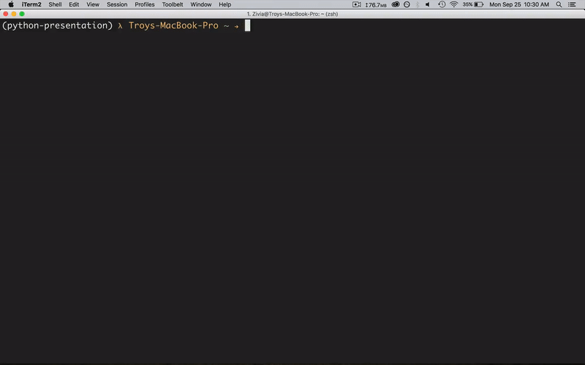
PyPy - Replacement for CPython
Emphasis on speed (JIT compiled), roughly 7x speedup
Supports all of core language, and most standard libraries
Drop-in replacement, essentially no code changes

Slide 25
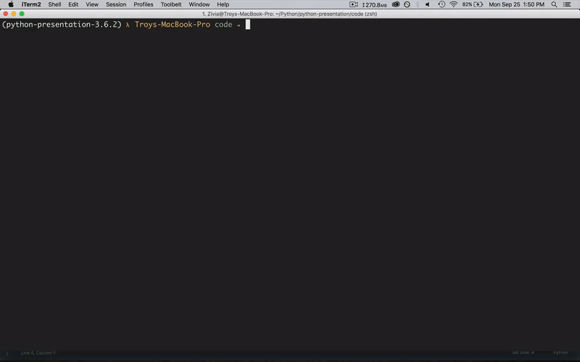
Cython - C-Extensions for Python
Call back and fourth between Python and C/C++ natively
Interact with existing native code easily
C-like performance in Python with static type declarations

Slide 26
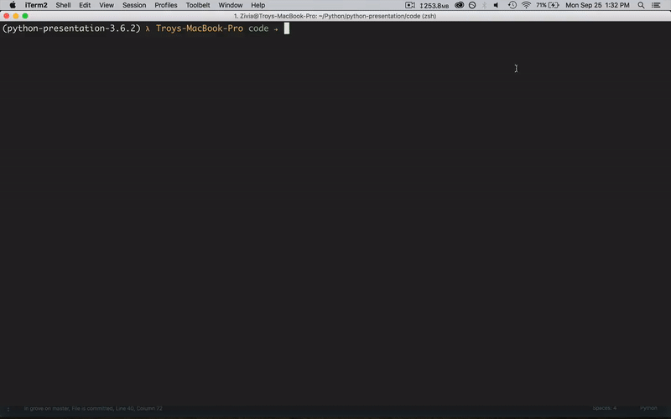
Numba - High Performance Functions
JIT-compile Python functions into LLVM IR
Supports GPU acceleration with CUDA and HSA
Up to 500x faster than standard Python

Slide 27
Useful Advanced Language Constructs
Decorators
Concise partial application for generating specialized functions
Context Managers
Easily manage operations that require entering and exiting a given context
Generators
A function that can return control flow to the caller without losing state, visited at a later point

Slide 28
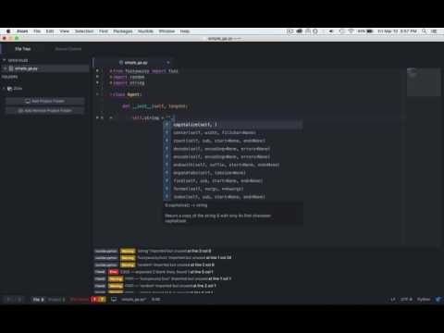
Demo - Simple Genetic Algorithm

